Slide 1
Wells Fargo Automotive Semiconductor Call
June 16, 2021
Gary Mobley
Wells Fargo Securities Senior Equity Analyst
IoT/Wireless & Data Center Semiconductors
314-255-4853 | gary.mobley@wellsfargo.com
Colin Langan
Wells Fargo Securities Senior Equity Analyst
Automotive & Mobility
212-214-8228| colin.langan@wellsfargo.com
Ashley McCurry
Wells Fargo Securities Associate Equity Analyst
IoT/Wireless & Data Center Semiconductors
347-931-6324 | ashley.mccurry@wellsfargo.com
Please see page 18 for rating definitions, important disclosures and required analyst certifications. All estimates/forecasts are as of 06/16/21 unless otherwise stated.
Wells Fargo Securities, LLC does and seeks to do business with companies covered in its research reports. As a result, investors should be aware that the firm may have a conflict of interest that could affect the objectivity of the report and investors should consider this report as only a single factor in making their investment decision.

Slide 2
Semi Impact on Autos
Timeline Into Crisis
Signs of Stabilization
Automakers Most Impacted
Current Auto Production Outlook

Slide 3
Timeline
December 2020
February 13th, 2021
Texas Winter Storm Impacts Infineon & NXP Production
VW, Conti, Bosch Warn of Semi Shortage Risks
March 19th, 2021
Renesas Fire
Current
Rising Panic Driving Double Ordering, Etc.
Q2 2020
OEMs Cancel Semi Orders During COVID
Q4 2020
Rapid Demand Recovery Drives Global Production Up 86% from Q2

Slide 4
Signs of Positive Progress
5/31: Renesas announces Naka Plant at 88% of pre-fire levels; targets 100% by mid-June
6/3: GM announces first half will be “significantly better” than prior guidance
6/6: VW comments the shortage at its worst now and getting better

Slide 5
Improving Trend on Semi Impact
IHS estimates lost Q1 production was 1.4m
The pace of Q2 production losses has moderated
Estimated Semi Related Lost Production in Q2 Trend
Source: IHS; Wells Fargo Securities, LLC

Slide 6
Watch Out For COVID & Drought Risks
Taiwan COVID Cases
None to Some
Downward Trend Recently
Closure of King Yuan Electronics due to high cases
Taiwan Drought Risk High
June 5th slight easing in water restrictions after weekend rain
Estimated ~70% of auto MCUs produced by Taiwan-based foundries.
Malaysia lockdown could impact the ~50 semi plants in the region.
Taiwan COVID Cases Trend
Source: Johns Hopkins University CSSE COVID-19 Data

Slide 7
Who is the most impacted?
N America is most impacted region
Ford, GM, VW, and STLA >50% of impact
JIT Inventory and 3-6 Month Semi Lead-times Large Factors
Estimated Semi Related Lost Production in Q2 by OEMs
Estimated Semi Related Lost Production in Q2 by Region
Source: IHS; Wells Fargo Securities LLC
Source: IHS; Wells Fargo Securities LLC

Slide 8
What is the baseline production outlook?
IHS is currently forecasting 2021 up 11% y/y, though Q2 down 8% q/q.
11% may be optimistic since it reflect +8% from Q2 to Q3 and +21% from Q2 to Q4.
Ford hit the hardest so far.
2020-2021 Forecast/Actual Production
Source: IHS; Wells Fargo Securities LLC estimates
Estimated Q2 2021 Production vs. Q1 2021 and Q4 2020
Source: IHS; Wells Fargo Securities LLC

Slide 9
But everyone is feeling the pain…
US Inventory only at 25 days ending May
Inventory is lean across all the automakers
US Inventory Days on Hand Trend
May 2021 US Inventory Days on Hand by Automaker
Source: Wards Auto; Wells Fargo Securities LLC
Source: Wards Auto; Wells Fargo Securities LLC
9

Slide 10
And it’s impacting many key products…
May 2021 US Inventory Days on Hand by Product
Source: Wards Auto; Wells Fargo Securities LLC

Slide 11
Sales Still Holding Up for Now
US SAAR Trend
W Europe SAAR Trend
Source: Wards Auto; Wells Fargo Securities LLC
Source: IHS; Wells Fargo Securities LLC

Slide 12
What is the risk to supplier guidance?
Source: Company Reports; Wells Fargo Securities LLC

Slide 13
Automotive Semi Thesis: Expecting Prolonged Automotive Chip Recovery – Playing for CY22 Upside to Consensus Views
Key message – Continue to overweight semiconductor companies with outsized exposure to the automotive end market:
Top large-cap automotive chip idea: NXPI
Top small-cap automotive chip idea: ALGM
Short-term view/catalysts – own them for the automotive semiconductor super cycle
Long-term view/catalysts – own them for the secular growth as driven by more semiconductor content per vehicle driven by ADAS, xEV, AV
In this note, we provide the different data points supporting our super cycle thesis:
Expect automotive semiconductor sales to remain strong for balance of 2021, recording ~30% growth for the year
Expect automotive semiconductor market to grow closer to 15% in CY22 vs. consensus view of HSD-% growth
This is what we’re playing for, potential upside to CY22 consensus views
Reason why we recently raised ests for ALGM.

Slide 14
Automotive Semi Thesis: Expecting Prolonged Automotive Chip Recovery – Playing for CY22 Upside to Consensus Views contd.
Leading drivers for a prolonged auto chip recovery:
Expect high global COVID-19 vaccination rates to provide better demand backdrop for new car sales
Seeing this now, albeit in fits and starts
Auto dealers need to restock inventory (inventories at lowest levels in decades)
Automotive chip inventories need to be restocked (lowest levels in decades, to the point it has impacted auto production)
Top two things investors may fail to appreciate:
A post pandemic view of auto chip supply chain – What may change is that auto supply chain may carry more chip inventories (no more JIT?)
May take longer than expected to bring auto chip supply/demand back into balance – e.g. mid-CY22 before supply/demand balance

Slide 15
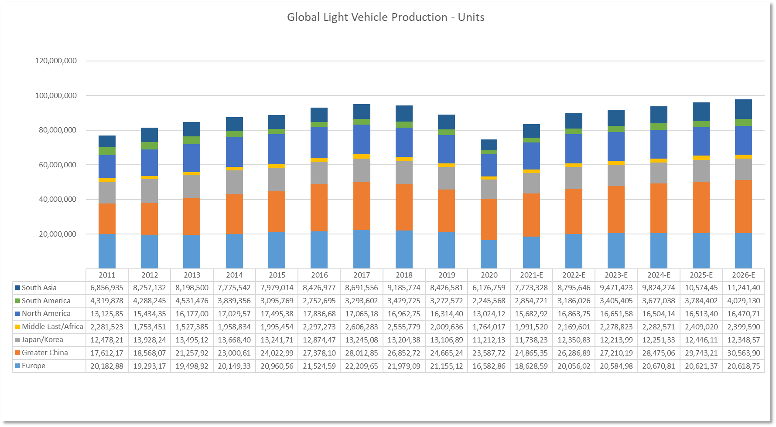
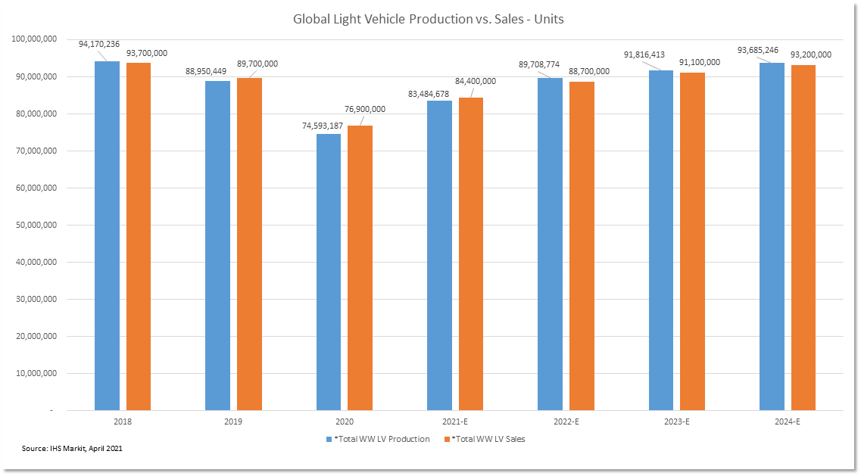
The Cyclical Portion of Our Automotive Semiconductor Super Cycle Thesis
Source: IHS Markit, May 2021

Slide 16
The Secular Dynamic of the Automotive Semiconductor Super Cycle Thesis

Slide 17
Links to Notes and Pricing Data
Expecting Prolonged Automotive Chip Recovery – Playing for CY22 Upside to Consensus Views
ALGM: Updated Thoughts on Automotive Semiconductor Super Cycle Thesis
Semi Update: Fragile Recovery, Handle with Care
Industrials Conference Recap, More Clarity on Semis
Ticker | Intraday Prices (as of 6/16)
ALGM | $27.25
NXPI | $200.36

Slide 18
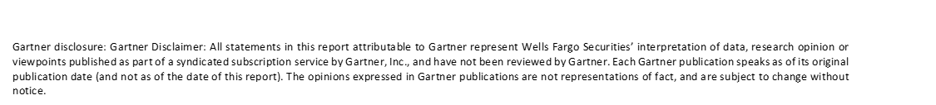
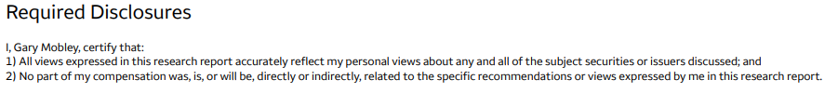
Footnote: Wells Fargo Disclosures Link

Slide 19
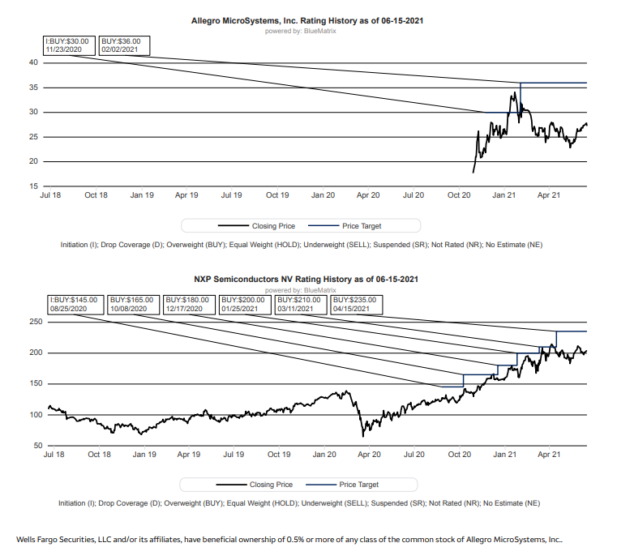
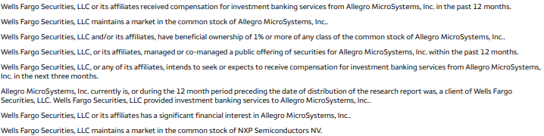

Slide 20
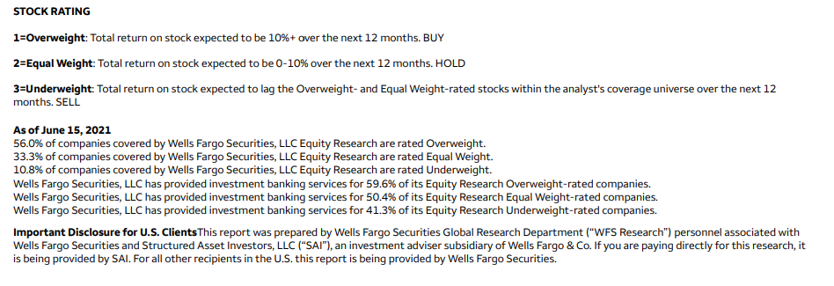
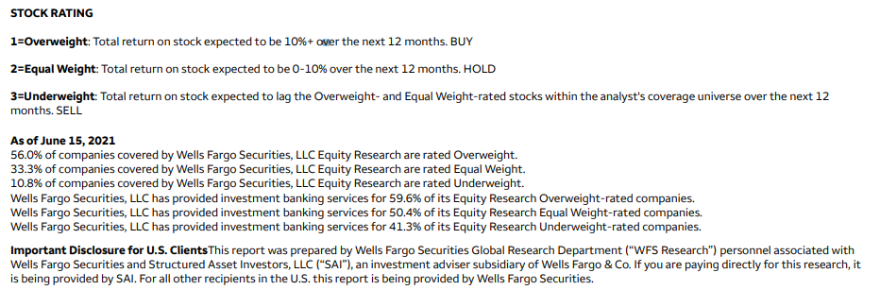

Slide 21
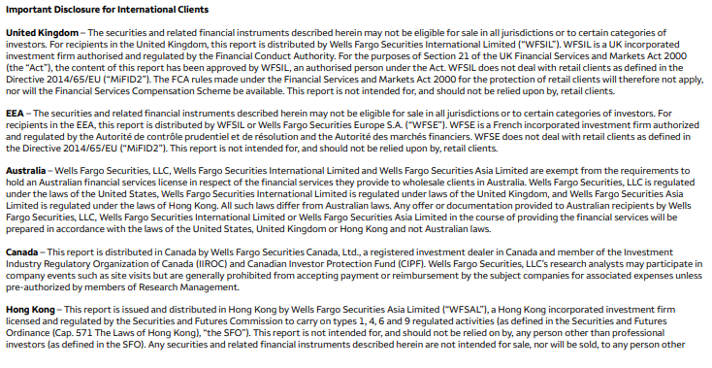
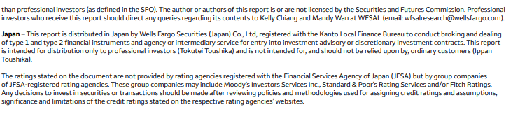

Slide 22
